Slide 1
Chapter 2 (Part 2)
Database Environment

Slide 2
Chapter 2 (Part 2)- Objectives
Purpose/importance of conceptual modeling.
Typical functions and services a DBMS should provide.
Function and importance of system catalog.
Software components of a DBMS.
Meaning of client–server architecture and advantages of this type of architecture for a DBMS.
Function and uses of Transaction Processing Monitors.

Slide 3
Conceptual Modeling
Conceptual schema is the core of a system supporting all user views.
Should be complete and accurate representation of an organization’s data requirements.
Conceptual modeling is process of developing a model of information use that is independent of implementation details. Such as target DBMS, application programs, programming language etc
This model is called conceptual data model.

Slide 4
Functions of a DBMS
Data Storage, Retrieval, and Update.
This is fundamental function of DBMS.
A DBMS must furnish users with the ability to store, retrieve and update data in the database.
A User-Accessible Catalog.
A DBMS must provide a catalog in which descriptions of data items are stored and which is accessible to users.
A system catalog or data dictionary is a repository of information describing the data in the database.

Slide 5
Functions of a DBMS
Transaction Support.
A DBMS must provide a mechanism which will ensure either that all the updates corresponding to a given transaction are made or that none of them is made.
A transaction is a series of actions, carried out by a single user or application program, which accesses or changes the contents of the database
For example: add new staff member to the database, update the salary of staff members etc.

Slide 6
Functions of a DBMS
Concurrency Control Services.
A DBMS must furnish a mechanism to ensure that the database is updated correctly when multiple users are updating the database concurrently.
It enables many users to access shared data concurrently.
The DBMS must ensure that, when multiple users are accessing the database, interference cannot occur.

Slide 7
Functions of a DBMS
Recovery Services.
A DBMS must furnish a mechanism for recovering the database in the event that the database is damaged in any way.
This may result of system crash, a hardware or software error causing the DBMS to stop, or it may be the result of the user detecting the error during transaction & aborting the transaction.
Authorization Services.
A DBMS must furnish a mechanism to ensure that only authorized users can access the database.

Slide 8
Functions of a DBMS
Support for Data Communication.
A DBMS must be capable of integrating with communication software.
Most users access the database from workstations. Sometimes these workstations are connected directly to the computer hosting the DBMS.
In other cases, the workstations are at remote locations & communicate with the computer hosting the DBMs over the network. In either case, the DBMS receives requests as communications messages and responds in a similar way. All such transmissions are handled by a Data Communication Manger(DCM), DCM is not part of DBMS .it is necessary for DBMS to be capable of being integrated with variety of DCMs if the system is to be commercially viable.

Slide 9
Functions of a DBMS
Integrity Services.
A DBMS must furnish a means to ensure that both the data in the database and changes to the data follow certain rules.
Database integrity refers to the correctness and consistency of stored data, it can be considered as another type of database protection.
Services to Promote Data Independence.
A DBMS must include facilities to support the independence of program from the actual structure of the database.
Data independence has already been discussed.

Slide 10
Functions of a DBMS
Utility Services.
A DBMS should provide a set of utility services.
Utility services help the DBA to administer the database effectively.
Some utility work at the external level, & consequently can be produced by DBA.
Other utilities work at the internal level & can be provided by the DBMS vendor.

Slide 11
System Catalog
It is repository of information (metadata) describing the data in the database.
One of the fundamental components of DBMS.
Typically stores:
names, types, and sizes of data items;
constraints on the data;
names of authorized users;
data items accessible by a user and the type of access;
usage statistics.

Slide 12
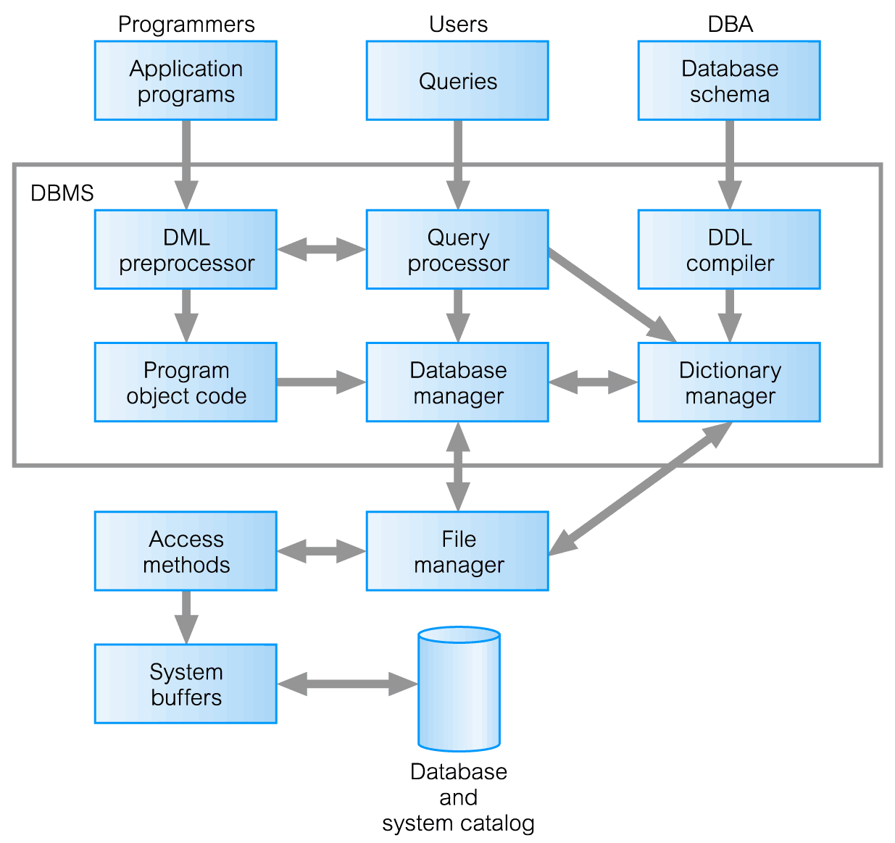
Components of a DBMS

Slide 13
Components of a DBMS
Query processor
This is a major DBMS component that transforms queries into a series of low-level instructions directed to the database manager.
Database Manager (DM)
The DM interfaces with user-submitted application programs and queries.
The DM accepts queries & examines the external and conceptual schemas to determine what conceptual records are required to satisfy the request.
The DM then places a call to the file manger to perform the request.

Slide 14
Components of a DBMS
File Manger
It manipulates the underlying storage files and manages the allocation of the storage space on disk.
It establishes and maintains the list of structures and indexes defined in the internal schema.
The file manger does not directly manage the physical input and output of data.
Rather it passes the request on to the appropriate access methods, which either read data from or write data into the system buffer (or cache).

Slide 15
Components of a DBMS
DML preprocessor
This module converts DML statements embedded in an application program into standard function calls in the host language.
The DML preprocessor must interact with the query processor to generate the appropriate code.
DDL compiler
The DDL compiler converts DDL statements into a set of tables containing metadata.
These are then stored in the system catalog while control information is stored in data file headers.
Catalog manager
It manages access to and maintains the system catalog.
The system catalog is accessed by most DBMS components.

Slide 16
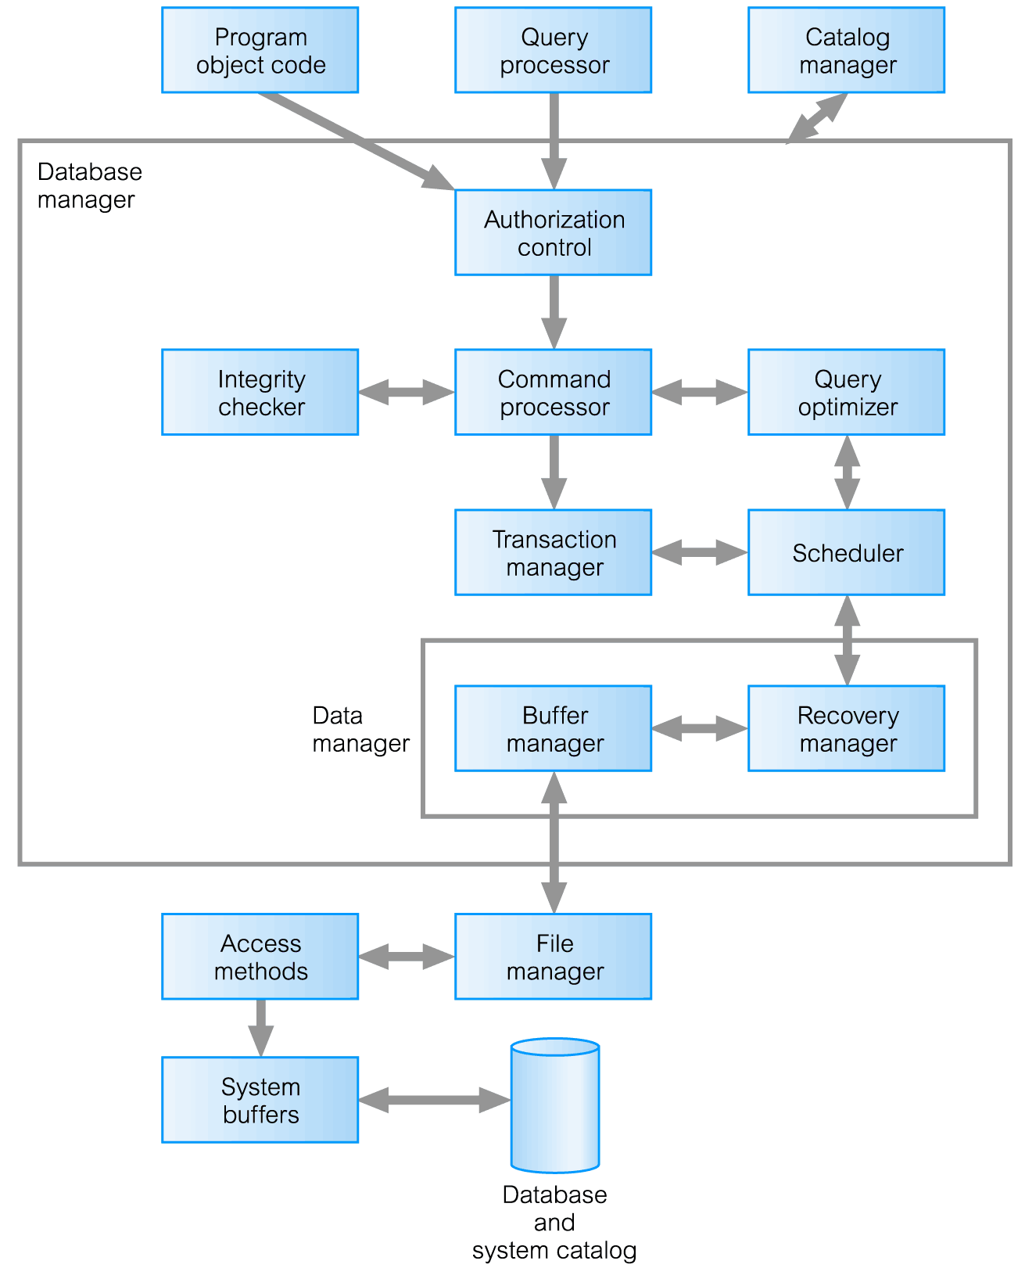
Components of Database Manager (DM)

Slide 17
Components of Database Manager (DM)
Authorization control
This module checks that the user has the necessary authorization to carry out the required operation
Command processor
Once the system has checked that user has authority to carry out the operation, control is passed to the command processor.
Integrity checker
It checks that the requested operation satisfies all necessary integrity constraints.
Query optimizer
It determines an optimal strategy for the query execution.

Slide 18
Components of Database Manager (DM)
Transaction manger
This module performs the required processing of operations it receives from transactions.
Scheduler
It is responsible for ensuring that concurrent operations on the database proceed without conflicting with one another.
Recovery manger
It ensures that the database remains in consistent state in the presence of failures.
Buffer manger
It is responsible for the transfer of data between main memory and secondary storage.

Slide 19
Multi-User DBMS Architectures
Common architectures that are used to implement multi-user database management systems are:
Teleprocessing
File-server
Client-server

Slide 20
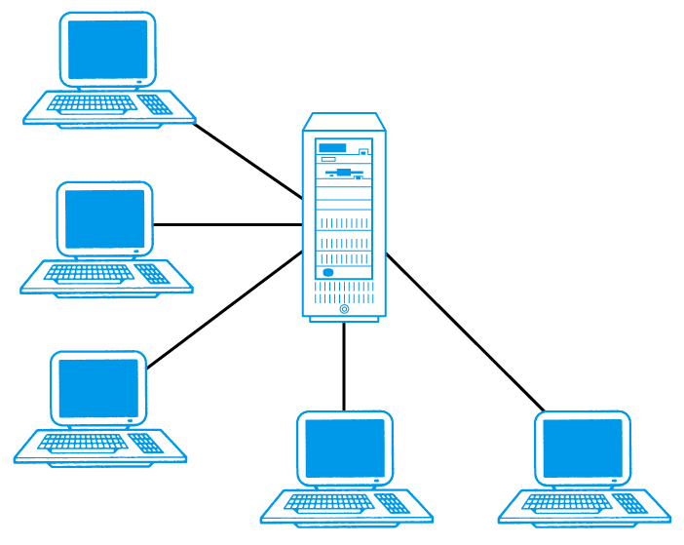
Teleprocessing
Traditional architecture for multi-user systems.
Single CPU with a number of terminals attached.
This architecture placed a tremendous burden on the central computer, which not only had to run the application programs and the DBMs but also had to carry out a significant amount of work on behalf of the terminals (such as formatting data for display on the screen.

Slide 21
Teleprocessing
Trend is now towards downsizing, that is replacing expensive mainframe computers with more cost-effective networks of personal computers that achieve the same or even better results.
This trend has given rise to the next two architectures : file-server and client-server.

Slide 22
File-Server
File-server is connected to several workstations across a network.
Database resides on file-server.
DBMS and applications run on each workstation.
Disadvantages include:
Significant network traffic.
Copy of DBMS on each workstation.
Concurrency, recovery and integrity control more complex.

Slide 23
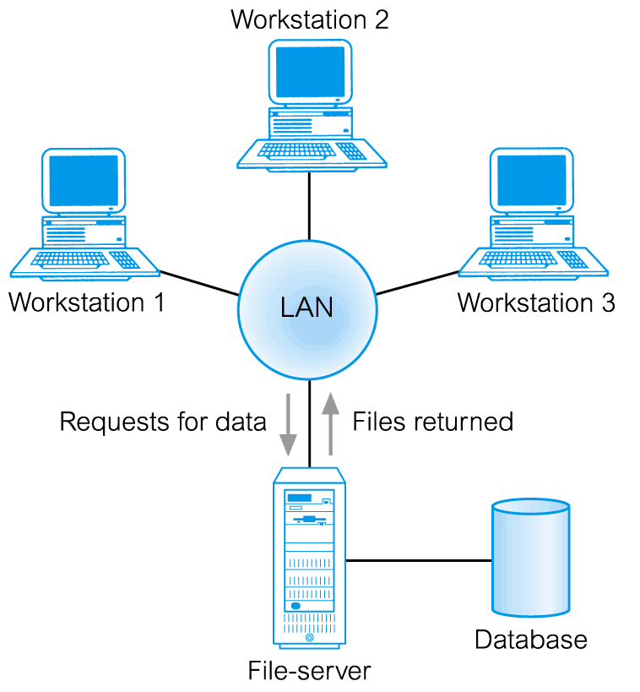
File-Server Architecture

Slide 24
Traditional Two-Tier Client-Server
Client-server refers to the way in which software components interact to form system.
There is a client process, which requires some resource & server, which provide the resource.
The client (tier 1) is primarily responsible for presentation of data to the user & server (tier 2) is primarily responsible for supplying data services to the client.

Slide 25
Traditional Two-Tier Client-Server
Client (tier 1) manages user interface and runs applications.
Server (tier 2) holds database and DBMS.
Client Tasks:
Manages the use interface
Accepts & checks syntax of user input
Processes application logic
Generate database requests and transmits to server.
Passes response back to user

Slide 26
Traditional Two-Tier Client-Server
Server Tasks:
Accepts & processes database from clients
Checks authorization
Ensure integrity constraints not violated
Performs query/update processing and transmits response to client
Maintains system catalog
Provide concurrent database access
Provides recovery control.
Advantages include:
wider access to existing databases;
increased performance;
possible reduction in hardware costs;
reduction in communication costs;
increased consistency.

Slide 27
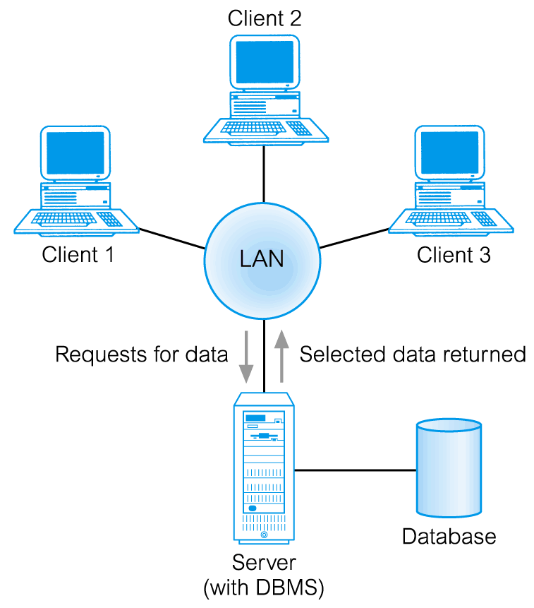
Traditional Two-Tier Client-Server

Slide 28
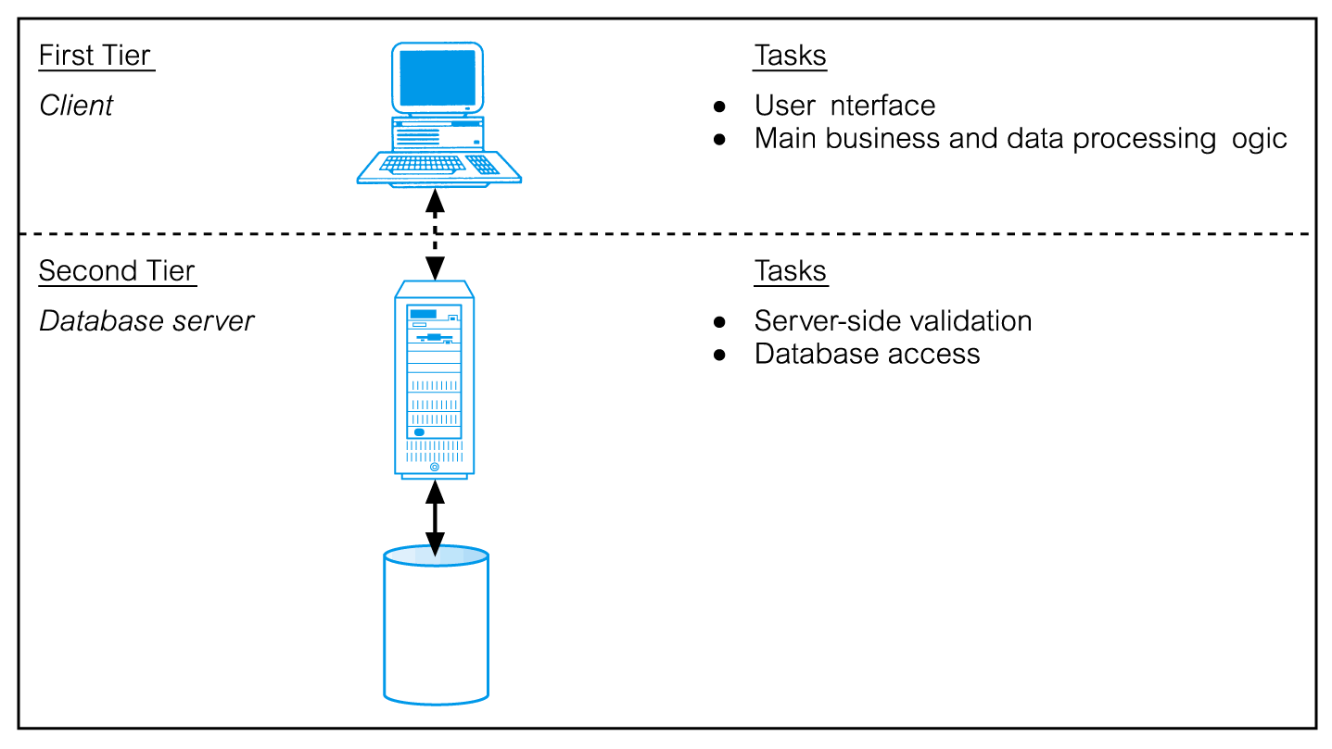
Traditional Two-Tier Client-Server

Slide 29
Three-Tier Client-Server
Client side presented two problems preventing true scalability:
‘Fat’ client, requiring considerable resources on client’s computer to run effectively.
Significant client side administration overhead.
By 1995, three layers proposed, each potentially running on a different platform.

Slide 30
Three-Tier Client-Server
The user interface layer, which runs on the end-user’s computer( the client).
The business logic and data processing layer, This middle tier runs on a server and is often called application server.
A DBMS, which stores the data required by the middle tier. This tier may run on a separate server called the database server.

Slide 31
Three-Tier Client-Server
Advantages:
‘Thin’ client, requiring less expensive hardware.
Application maintenance centralized.
Easier to modify or replace one tier without affecting others.
Separating business logic from database functions makes it easier to implement load balancing.
Maps quite naturally to Web environment.

Slide 32
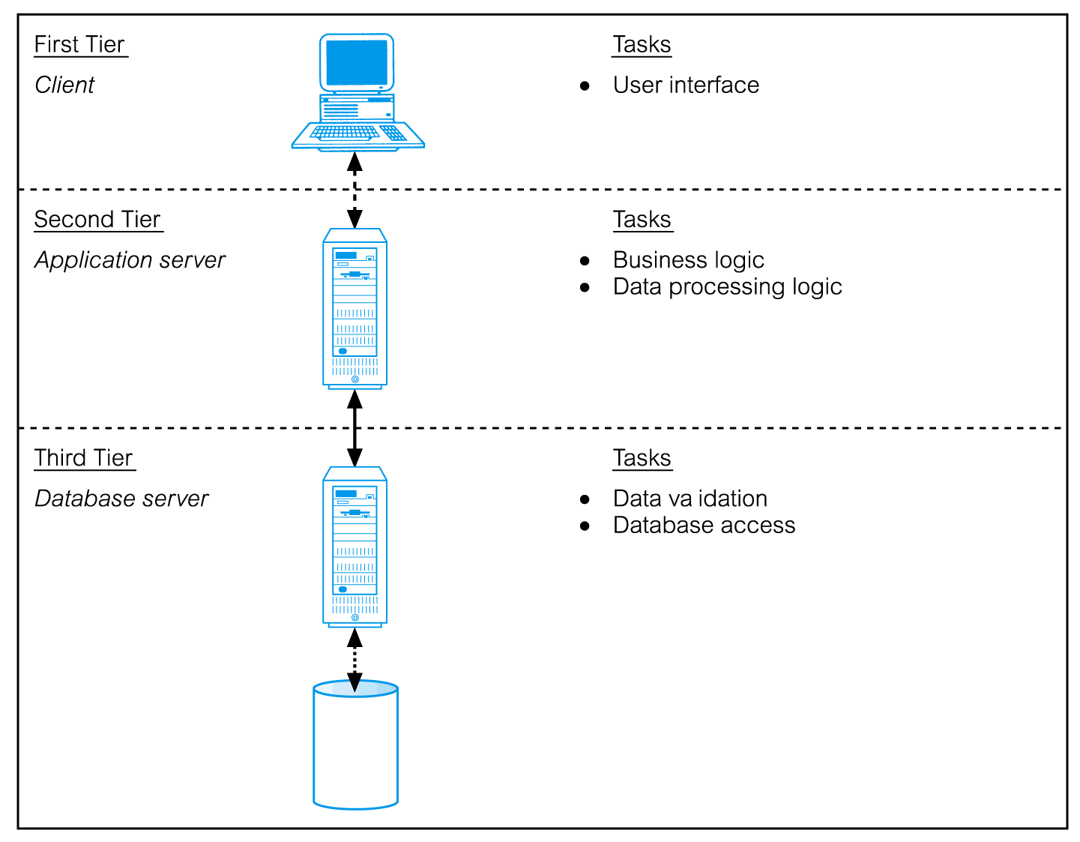
Three-Tier Client-Server

Slide 33
Transaction Processing Monitors
Program that controls data transfer between clients and servers in order to provide a consistent environment, particularly for Online Transaction Processing (OLTP).

Slide 34
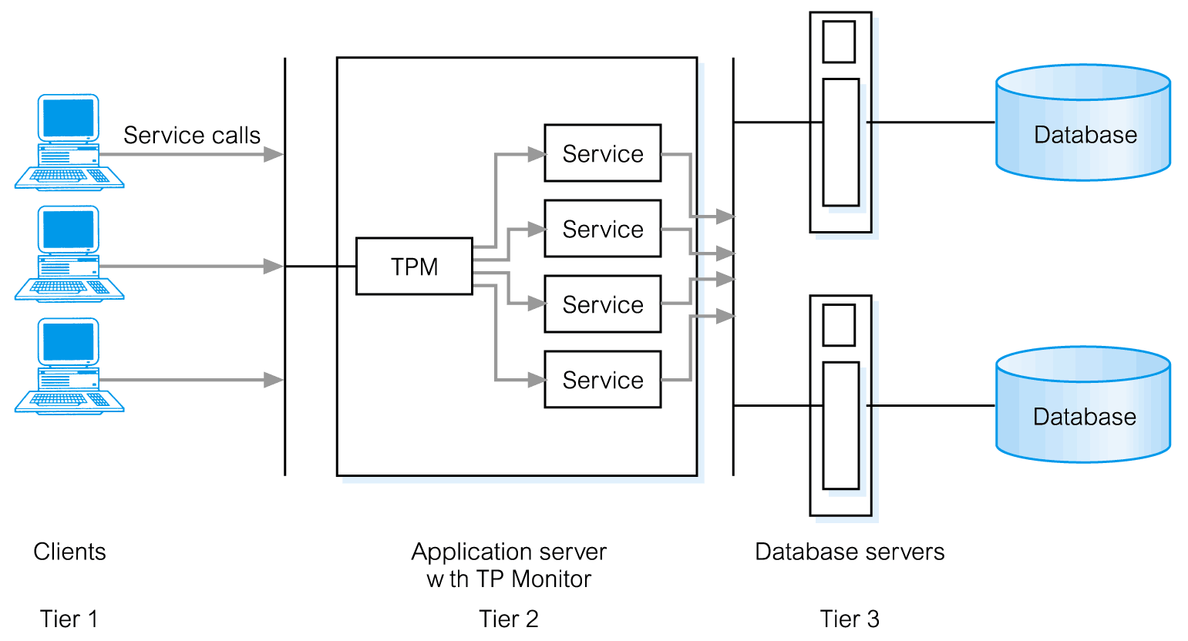
TPM as middle tier of 3-tier client-server

Slide 35
TPM as middle tier of 3-tier client-server
Advantages include:
Transaction routing
The TP monitor can increase scalability by directing transactions to specific DBMSs
Managing distributed transactions
TP monitor can manage transactions that require access to data held in multiple, possibly heterogeneous, DBMs.

Slide 36
TPM as middle tier of 3-tier client-server
Load balancing
TP monitor can balance client requests across multiple DBMSs on one or more computers by directing client service calls to the least loaded server.
Funneling
In environments with large number of users, it may sometimes be difficult for all users to be logged on simultaneously to the DBMS.
In many cases, we would find that users generally do not need continuous access to the DBMS.

Slide 37
TPM as middle tier of 3-tier client-server
Instead of each user connecting to the DBMS, the TP Monitor can establish connections with the DBMs as and when required,
And can funnel user requests through these connections.
This allows a larger number of users to access the available DBMSs with a potentially mush smaller number of connections, which in turn would mean less resource usage.
Increased reliability
The TP monitor acts as s transaction manager, performing the necessary actions to maintain the consistency of the database, with DBMS acting as a resource manager.
If the DBMS fails , the TP monitor may be able to retransmit the transaction to another DBMS or can hold the transaction until the DBMS becomes available again.

